Slide 1
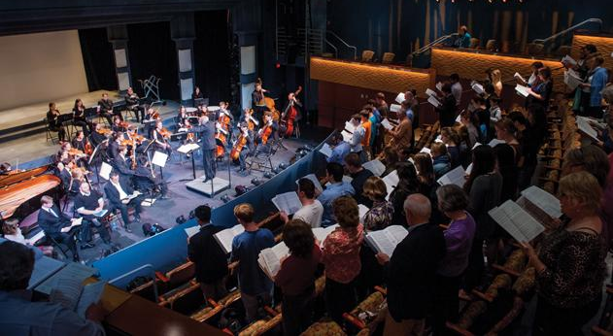
Performing Arts
Advisory Council
FY20 Budget Application

Slide 2
FY20 vs. FY21
FY19 Request
$82,000
FY19 Allocation
$37,000
FY20 Request
$75,000
FY20 Allocation
$50,000
FY21 Request
$85,000
FY20 Supported 20 Groups→ FY21 Supporting 25 Groups
Georgetown University Dance Company
Black Movements Dance Theatre
Ballet Folklorico
Ritmo y Sabor
Mask & Bauble Dramatic Society
Black Theatre Ensemble
Children’s Theater
Corpus
Pep Band
World Percussion Ensemble
Groove Theory
Georgetown GraceNotes
Georgetown Superfood
Georgetown Saxatones
15. Nomadic Theatre
16. GU Improv
17. Break Squad
18. Lombardi Ensemble Association for Patients (LEAP)
19. The Capitol G’s
20. Georgetown Phantoms
21. Vibe_ (in the NCD Process)
22. Hoya Blue Diamonds (In the NCD process)
23. Afromovez (In the NCD process)
24. GUzaarish (In the NCD process)
25. Origins (In the NCD Process)

Slide 3
FY21 Request:
$85,000
Reasoning:
10% projected increase in group requests
Trends from FY17-FY20 have shown a steady 10% increase in group requests for season programming.
Increase in expected ad hoc
FY20 ad hoc was abnormally low so far with only $7,700 to date.
Average ad hoc is $31,000 from FY10-20.
Expected replacements
Poulton Floor is expected to be redone next year (Average cost of $50,000-100,000).
Costs of building materials for sets for plays continue to rise.

Slide 4
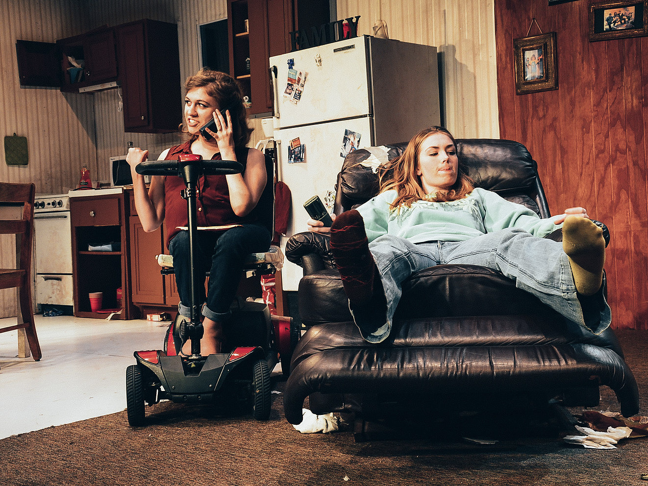
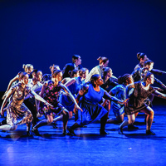
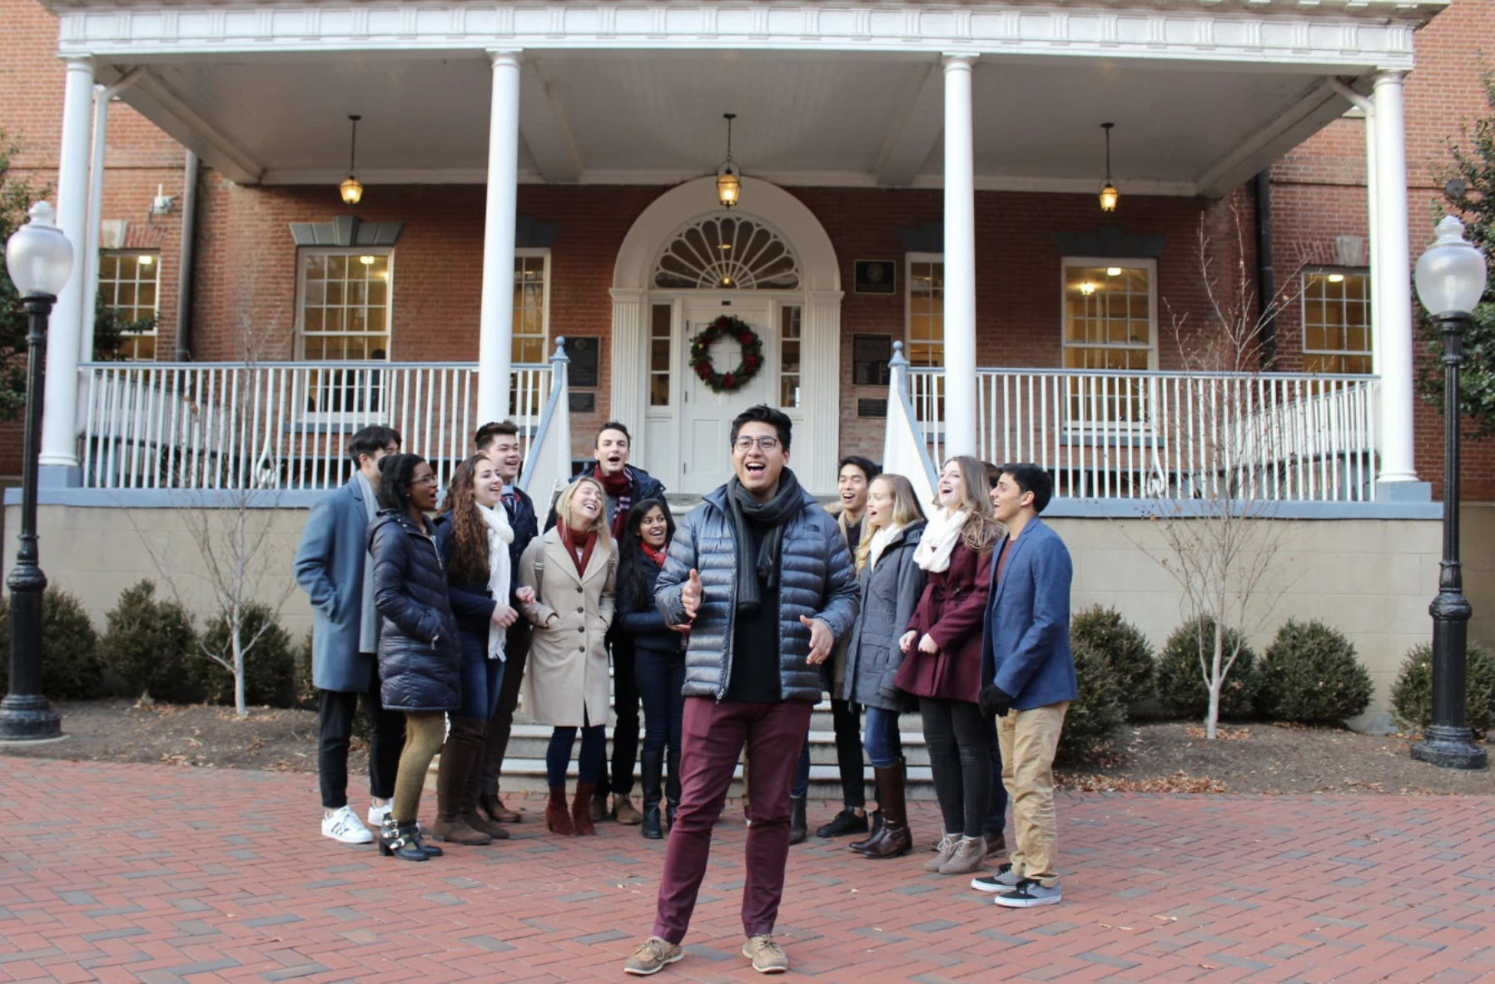
This year’s budget request supports:
Regular Season Programming
Club Operations
Travel Opportunities
Recording Opportunities
Special Events

Slide 5
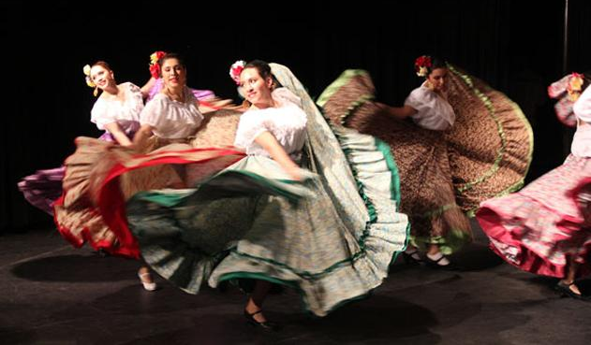
The PAAC Reserve Account
FY20: Projected Loss of $26,000
PAAC has the largest reserve account of any group.
This account is older than the student activities fee, and for decades was an interest-bearing account so accrued a high balance over time. (35 years)
PAAC supports groups who could feasibly have a six-figure emergency expense (ex: a broken light board, a dance floor), so the amount of the reserve account correlates to that.
The past two years, the reserve account amount went down to pay for our yearly programming

Slide 6
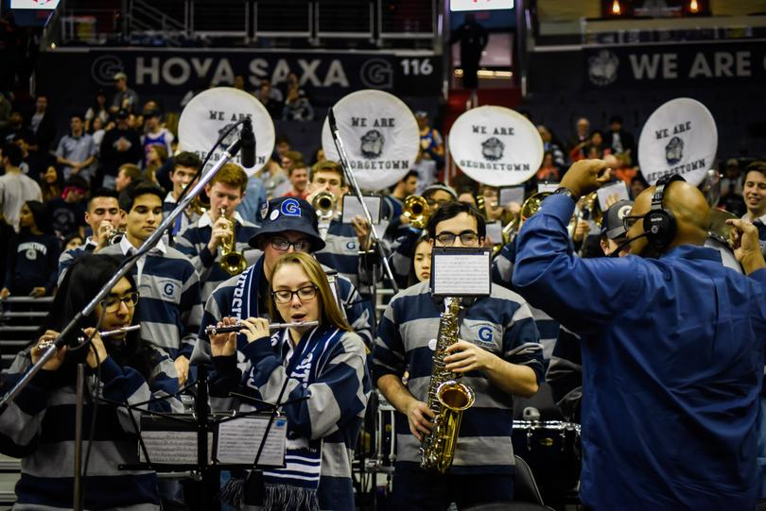
PAAC Changes Over FY20
Putting control back in the hands of students:
First Student Chair in the recent past
Every allocation, regardless of amount, is approved directly by student representatives. This is a change from FY19.
Fully revamped budgeting and ad hoc guidelines
Increased transparency:
Student liaisons taking extra steps to share meeting minutes with groups and check in throughout the year.

Slide 7
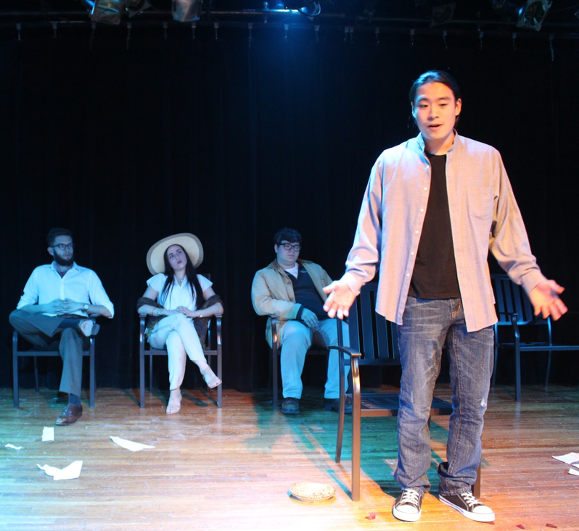
Updated Guidelines
Student representatives have worked diligently over FY19 to update funding guidelines for groups.
Ad Hoc funding guidelines have been updated for common ad hoc requests (travel, events, etc.).
A general mission statement has been developed based on themes we often look for in group budget applications (does work primarily occur on campus, how will groups enhance the current arts program, etc.).
The Performing Arts Advisory Council exists to support the growth and development of performing arts student organizations at Georgetown University. In particular, we support groups whose main missions centers on performance and we primarily fund activities that occur on campus and add to student life.

